Slide 1


Slide 2
Some examples of observations made to your project and discussion submissions
Amazon, eBay, etc., are like the Malls, you should mention the actual vendor.
In the case of vendors, remember to describe the limits of your population under analysis, and how exactly you collected the samples form that population.
Do not just copy the raw table from Excel or R, provide a good format (e.g., remove the grid lines)
Support with data results, all the claims you make.
Use the descriptive titles I explained in class to describe your tables and figures
Balance colors in tables and figures.
Tables need professional presentations.
Web links should not be active in a report (underlined and blue).
Improve the presentation of web links.
Keep consistency on decimals.
Use the appropriate symbols ($ in this case).
If there are no values for shipping cost, why did you include that additional column?
Indicate the measure on the top, e.g., Speed (Km/H), Weight (Grams).
You did not explain how your data was collected, and why it is random.
Your data collection must be random. From a list, you could use systematic sampling, in which the first item is selected randomly. If you have several vendors in mind, put their names in a box.

Slide 3
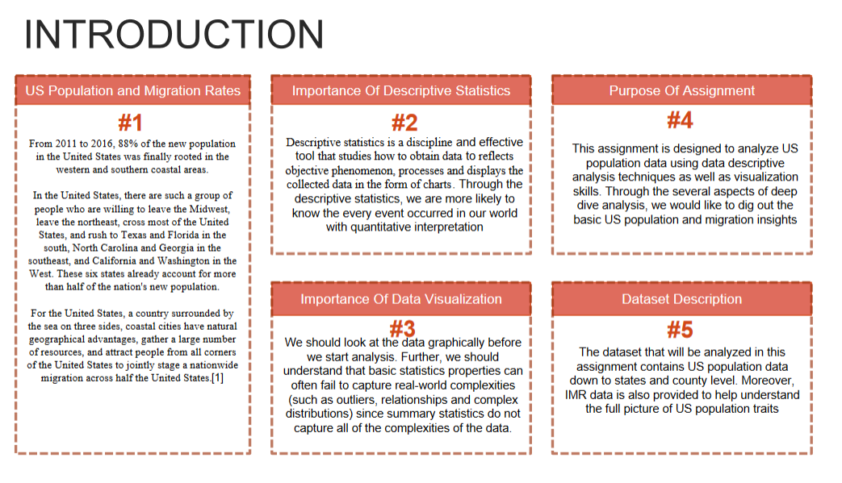

Slide 4
Informative titles:
For tables, add informative titles at the top and observations at the bottom.
For figures, add informative titles at the bottom and observations after.
Make sure your tables and figures are big enough to be clearly seen in the discussion board.
Improve the quality and significance of the comments and recommendations given to your classmates.
Provide some specific points.
Your observations to classmates must be related to data presentation and statistical analyses performed by your classmate.
You forgot to provide comments and recommendations given to your classmates.
If I ask you if you had any challenge, you should explain the challenge, and very important, what you did to overcome the problem.
Improve your answers, provide more information, be more specific and organize your thoughts.
Improve your critical thinking application to analyze results.

Slide 5
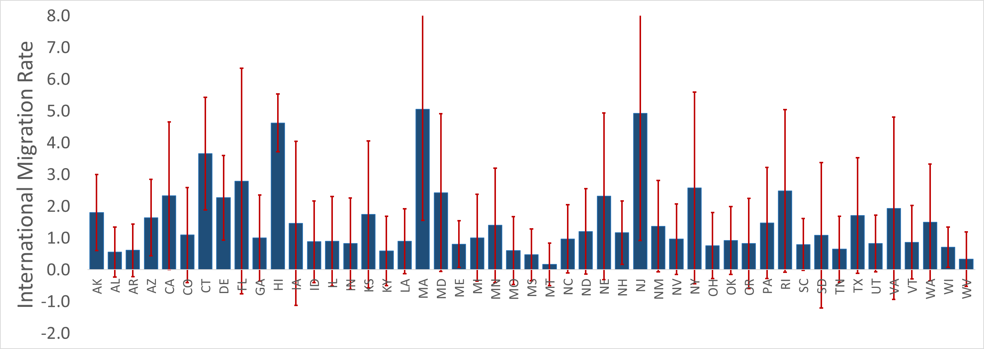
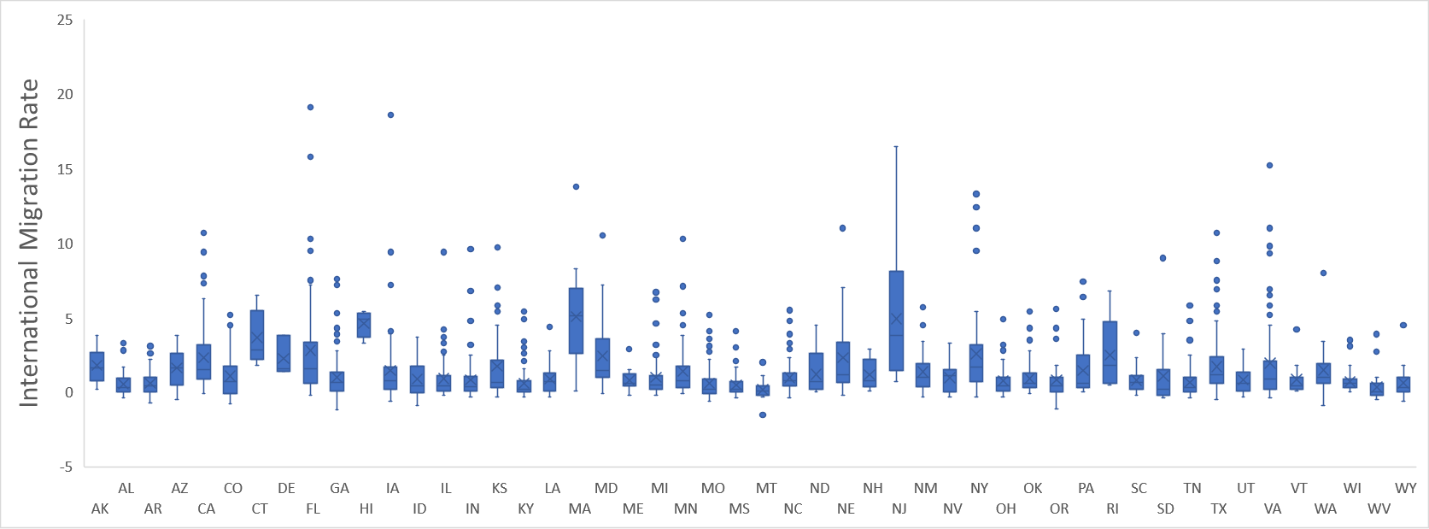
For this two figures, I provided clear examples in the assignment description.
Please pay attention, read carefully all your assignments.

Slide 6






Everybody, Please add a picture avatar to your CANVAS profiles.
Of your actual face.

Slide 7
Remember, Pay attention!!!

Slide 8

For the fun part, your presentations

Slide 9

When you present:
Explain the data in your tables and figures.
Explain what changes you made from the original figures and what you learnt in the process.
Explain the most important observation you made on each figure or table.
All students will improve their data presentations based on these recommendations
COLABORATION
teamwork
When you listen:
Tell your classmate your honest opinion about their figures (be nice of course).
Make recommendation on how to improve their data presentation.

